Slide 1
Investing for development: Supporting private investment for inclusive and sustainable agriculture-led economic growth
Panelists: Carlijn Nouwen, Dalberg Advisors
Afua Sarkodie, Dalberg Advisors
CJ Fonzi, Dalberg Advisors
John Bazley, Dalberg Advisors
Moderator: Janet Lawson, USAID Bureau for Food Security
Date: March 5, 2020

Slide 2
Afua Sarkodie,
Dalberg Advisors
As a Partner at Dalberg (based in New York) and current Team Leader for USAID’s Investment Support Program (ISP), a $60M five year framework contract, Afua has led numerous engagements focused on developing partnership strategies, assessing partnership best practices, and M&E for different partnership initiatives across the public, private and philanthropic sectors. With an 18 year career she brings a wealth of experience working with private sector partnerships and investment mobilization in the agriculture sector to achieve development goals.

Slide 3
Carlijn Nouwen,
Dalberg Advisors
Carlijn Nouwen is a Partner in Dalberg’s Johannesburg office. Carlijn is the global lead for Dalberg Advisors’ Inclusive Business Growth Expertise practice; working in particular on innovative finance and investment. She often works for private sector clients on market selection and market entry strategy to turn inclusive business into a lasting competitive advantage. She has worked with USAID’s ISP to conduct multiple projects assessing sector and crop viability in Malawi, Rwanda, Niger, and Liberia, as well as development and delivery of training around business models, business opportunities and investment opportunities.

Slide 4
CJ Fonzi,
Dalberg Advisors
CJ Fonzi is a Partner and the Director of Dalberg’s Kigali Office. His experience spans a broad range of development issues including impact investing, agriculture, and SME finance and support. He has worked with public and private sector investors, bi- and multi- lateral donors, non-profits, and multinational companies. CJ has deep expertise in Agriculture commercialization, including supporting USAID ISP to assess commercialization potential and specific export potential in eight value chains in Rwanda and support Rwanda’s National Agriculture Export Board and Rwanda Development board to actively promote investment in these areas.

Slide 5
John Bazley,
Dalberg Advisors
John Bazley is a Project Manager in Dalberg’s Washington DC office. He has worked with private corporations, NGOs, and foundations on strategy development, investment support, economic analysis, and business model development. His focus is on agriculture, impact investing, inclusive business models, and financial inclusion. He recently worked with USAID and KfW to identify ways to fund private sector innovators addressing malnutrition in SSA through a results-based, challenge fund approach, and has worked with USAID in assisting an investor with additional due diligence regarding the funding and development of a manufacturing facility for AD syringes in SADC.

Slide 6
Introduction
Primers
Insights

Slide 7
Investment Support Program
Commercial investment by the private sector is a core driver of economic growth and development. The Investment Support Program (ISP) is a five year Bureau for Food Security (BFS)-led program (implemented by Dalberg Advisors) that identifies investment opportunities, mobilizes private capital, and deepens private and financial sector engagement.
Through ISP, Missions have undertaken ~100 investment support activities, primarily in the agriculture sector. These range from value chain assessments and market analyses to sector mapping and other activities resulting in policy change, identification of investment opportunities, and strengthened capacity of Missions and host government agencies to facilitate investment for development impact.

Slide 8
Today’s objectives
Showcase a series of primers that have been developed to support USAID and its partners in facilitating private sector investment for inclusive and sustainable agriculture-led economic growth
Share our approach to investment opportunity identification and facilitation
Highlight key lessons drawing on the experience of ISP

Slide 9
Introduction
Primers
Insights

Slide 10
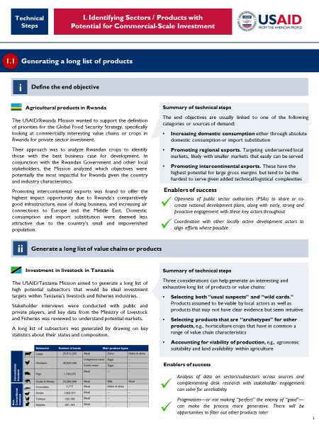
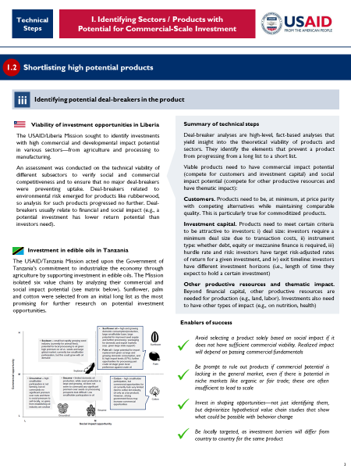
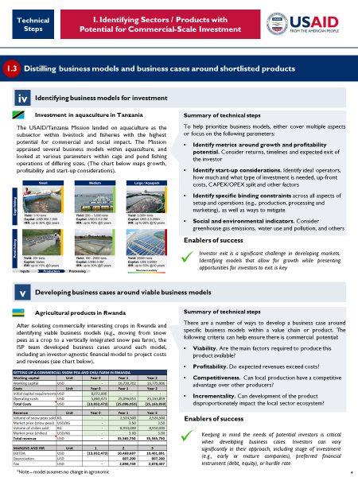
Primers
The set of primers seeks to illustrate the steps in ISP’s investment support process across three main areas:
1
Technical steps
Identifying sectors/products with potential for commercial- scale investment
2
Enabling environment
Mapping and addressing barriers that limit investment
3
Relationship building
Engaging investors and investees around prioritized opportunities

Slide 11
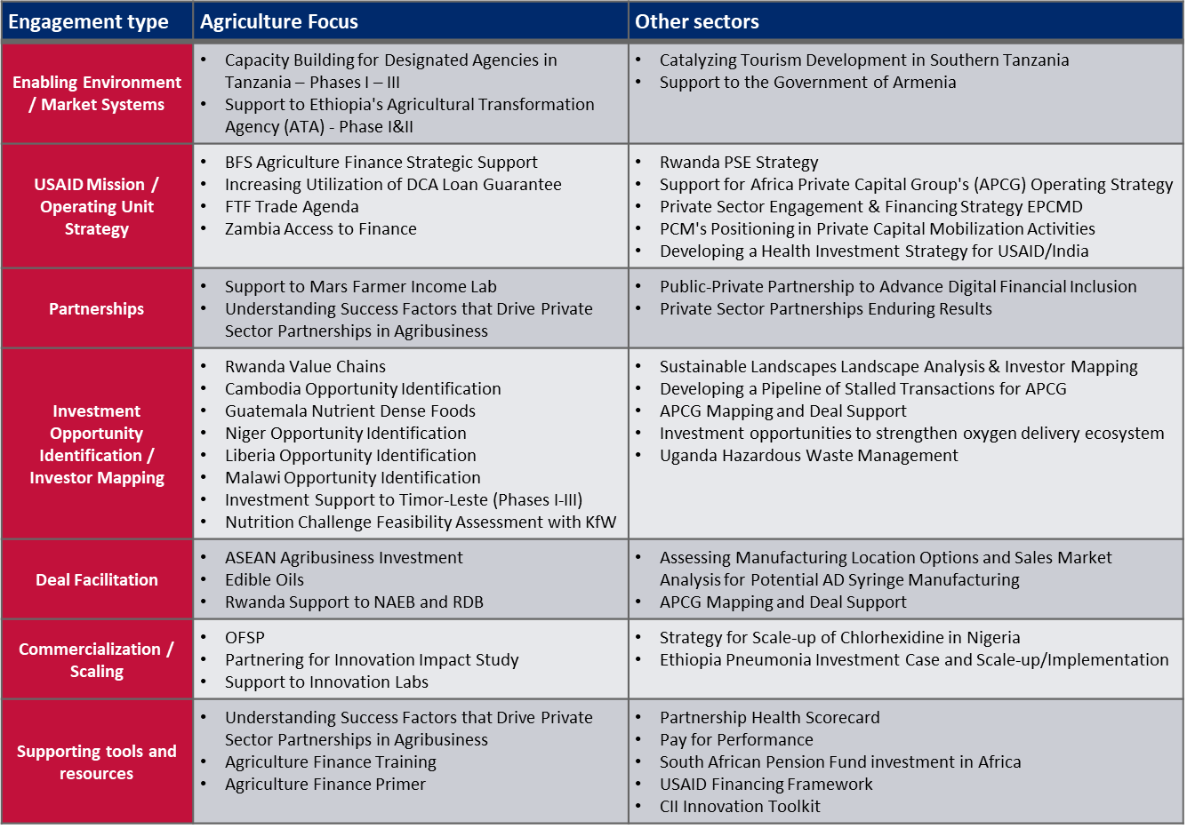
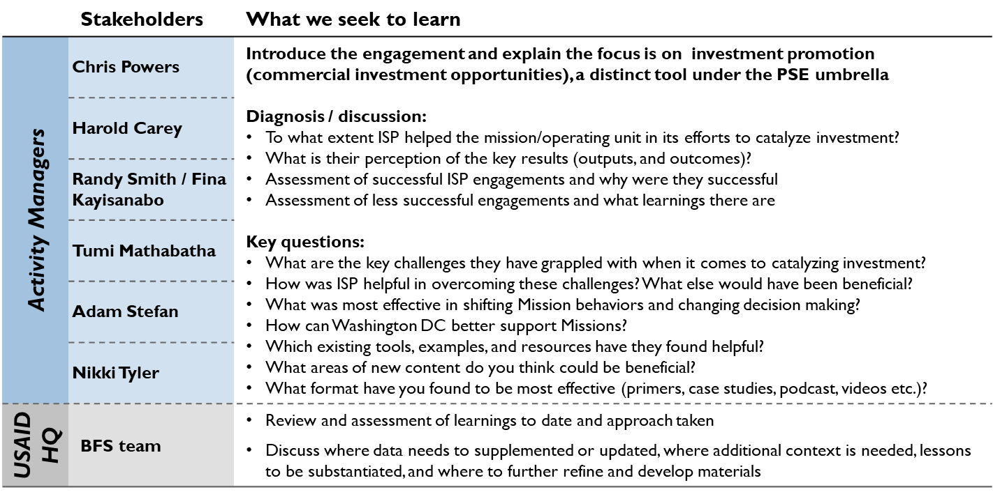
Methodology
Each primer is informed by the rich portfolio of ISP engagements…
… and targeted interviews with DC and Mission staff that have engaged with ISP repeatedly
Non-exhaustive listing of relevant engagements

Slide 12
Introduction
Primers
Insights

Slide 13
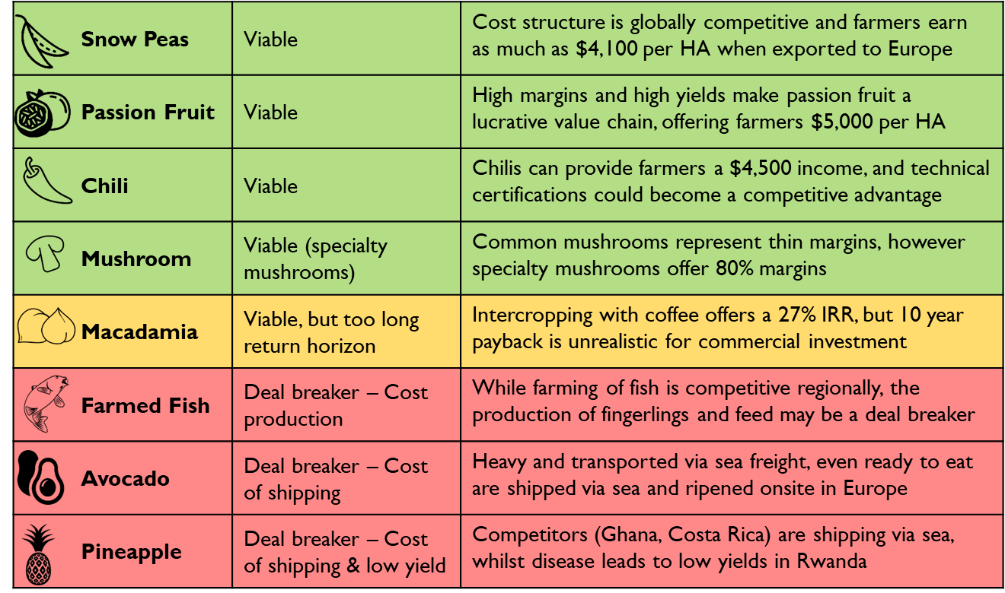
Example from Rwanda
Opportunity
Four value chains presented a viable business case for commercial investment
Horticulture export to Europe was an opportunity due to:
Growing demand in Europe for high-quality fresh produce
Difficulties in the Kenyan horticulture market in meeting minimum residue levels due to over-application of chemicals
Expansion of the national airline, bringing new direct routes from Kigali to Europe at affordable/subsidized prices
What does it take to identify commercial investment opportunities for development impact?
Notes:
Commercial investment by the private sector is a core driver of economic growth and development.
When USAID’s facilitation efforts are analytically and systematically completed, they can lead to more efficient efforts and funding, fewer distractions from interventions that may not work, more support to viable businesses, and, ultimately, more effective markets and growth.
Finding viable investment opportunities requires:
Understanding the scale required for commercial-level investment to attract investors and tangibly impact a sector
Taking a cold, hard look at competitiveness from different angles (e.g., competition between producing countries, competing sectors, and competition from needed resources)
However, investment cases cannot be based on:
Hypothetical value chain studies that show what could be possible with behavior change by producers (e.g., smallholder farmers)
The idea that something is viable, provided a long list of constraints are simultaneously resolved (often complicated by the fact that some constraints require behavioral change to gain resolution)
Targeting “niche” markets (e.g., organic) when they are not competitive in a commodity’s “basic” market

Slide 14
Primer 1: Identifying Sectors / Products with
Potential for Commercial-Scale Investment
Define the end objective – Increasing domestic consumption, promoting regional exports, or promoting intercontinental exports
Generate a long list of value chains or products – Selecting both “usual suspects” and “wild cards”, products that are “archetypes” for other products, and accounting for viability of production
Investment filtering process
1.1
Generating a long list of products
Identifying potential deal-breakers – Viable products need to have commercial impact potential (compete for customers and investment capital) and social impact potential (compete for other productive resources and have thematic impact).
1.2
Shortlisting high potential products
1.3
Distilling business models and business cases around shortlisted products
Identifying business models for investment – metrics around growth and profitability potential, start-up considerations, specific binding constraints, and social and environmental indicators
Developing business cases around viable business models – Viability, profitability, competitiveness, incrementality

Slide 15
Primer 1
Guiding principles
Take a business approach to honestly evaluating the competitiveness of products/value chains. A source of demand must be identified for the selected product/value chain
It is entirely possible to move into new products/value chains. Conversely, just because something exists is not a rationale for expansion
It is highly unlikely that organic, fair trade or “made in…” niche segments are sufficiently viable if the “basic” segment is not
Focus on explicitly identifying and addressing only the most pressing binding constraints.
Be mindful of potential unintended negative externalities

Slide 16
Primer 2: Mapping and addressing barriers that limit investment
Supporting the investment filtering process
Key considerations
2.1
Scan the policy landscape around the opportunity
Understanding the current enabling environment context, the degree of clarity and predictability, and the ways in which the policy framework affects investors
2.2
Identify key binding constraints
Policy, Social, and Technological barriers
2.3
Set recommendations to enhance investments
Partnerships, Skills gap support, and Policies
2.4
Help policy implementation
Convening of relevant forums to socialize recommendations, preparation of specific tools and presentation of supporting evidence for the recommendations
NOTE: Steps above need not occur in succession and do not map to the stages of the investment filtering process. They apply differently in different scenarios and contexts
Notes:
Unearthing investment opportunities for private sector actors adds value to the investment ecosystem and, when accompanied by tangible improvements to the enabling environment around specific value chains or business models, can lead to reduced delays and roadblocks during and post-investment. Typical reasons for delays and roadblocks are:
A general understanding of the wider policy landscape—but not in-depth around nuances of the specific investment opportunity
Differences in culture between investor, investee, facilitator and the public sector, which results in low engagement
However, strengthening specific aspects of the enabling environment, even if they are not binding constraints blocking an opportunity, may substantially accelerate/support opportunities:
Providing help to markets to function effectively through strong regulating bodies; providing support to domestic industries through the tactical use of regulation, such as tariffs
Providing smart investment support, such as selective use of temporary tax breaks to nurture and support new entrants
It should be noted that intervention in markets needs to be well considered as potential exists for market distortion through price ceilings and floors, export and import bans, or overly tight constraints on labor, trade and forex that can have adverse effects.

Slide 17
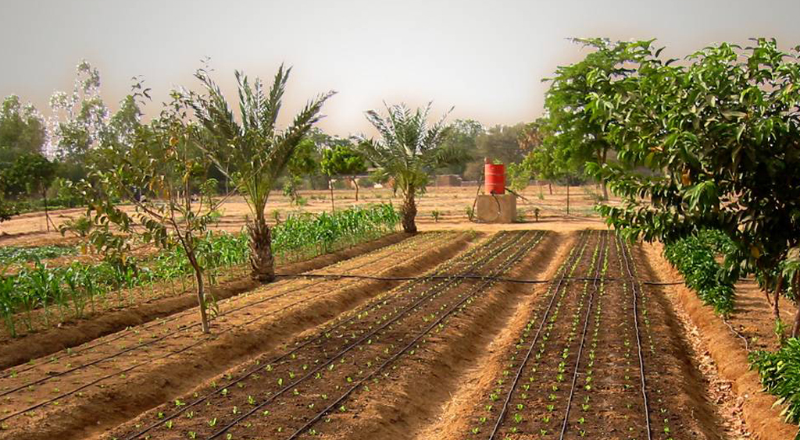
Primer 2
Guiding principles
Do not try to be comprehensive in the problems you seek to solve
Leverage local and national strategies, and use an investment opportunity as an avenue to drive progress
Be specific about the solution you aim to deliver
A highly tactical approach may be needed
Facilitate early, close and dedicated stakeholder engagement.
Understand the context before designing the intervention

Slide 18
Primer 3: Engaging Investors and Investees around Prioritized Opportunities
Investment filtering process
Key considerations
3.1
Map out key private investors and investees
Identifying local implementers/operators, global implementers/operators and investors as well as types and terms of financing sought.
3.2
Prioritize investors that are most aligned with USAID’s mission and objectives
Consider the investment thesis and expansion strategy
3.3
Reach out to prioritized investors and investees to pitch multiple investment opportunities
Develop an engagement strategy, present tailored pitch materials
3.4
Offer post-investment support
Engage regularly and convene private sector actors in thematic “private sector desks”
NOTE: This primer covers the mechanics of engaging investors and investees at the end of the investment support process from Primer 1
Notes:
Identifying impactful commercial investment opportunities and helping improve the enabling environment around them adds value, and, if accompanied by effectively facilitating investor and investee engagement, can lead to effective execution at this stage. Matching investors and investees around specific investment opportunities requires:
An already established network of private sector players across target sectors and subsectors
Regular and detailed exchanges and interaction with private sector players to gain a pulse on sector-level challenges/opportunities
Matchmaking cannot be based on:
Purely commercial considerations because social and other outcomes, such as high levels of engagement and positive environmental effects, as well as due diligence to avoid “bad actors”, are an integral part of USAID’s Private Sector Engagement Policy

Slide 19
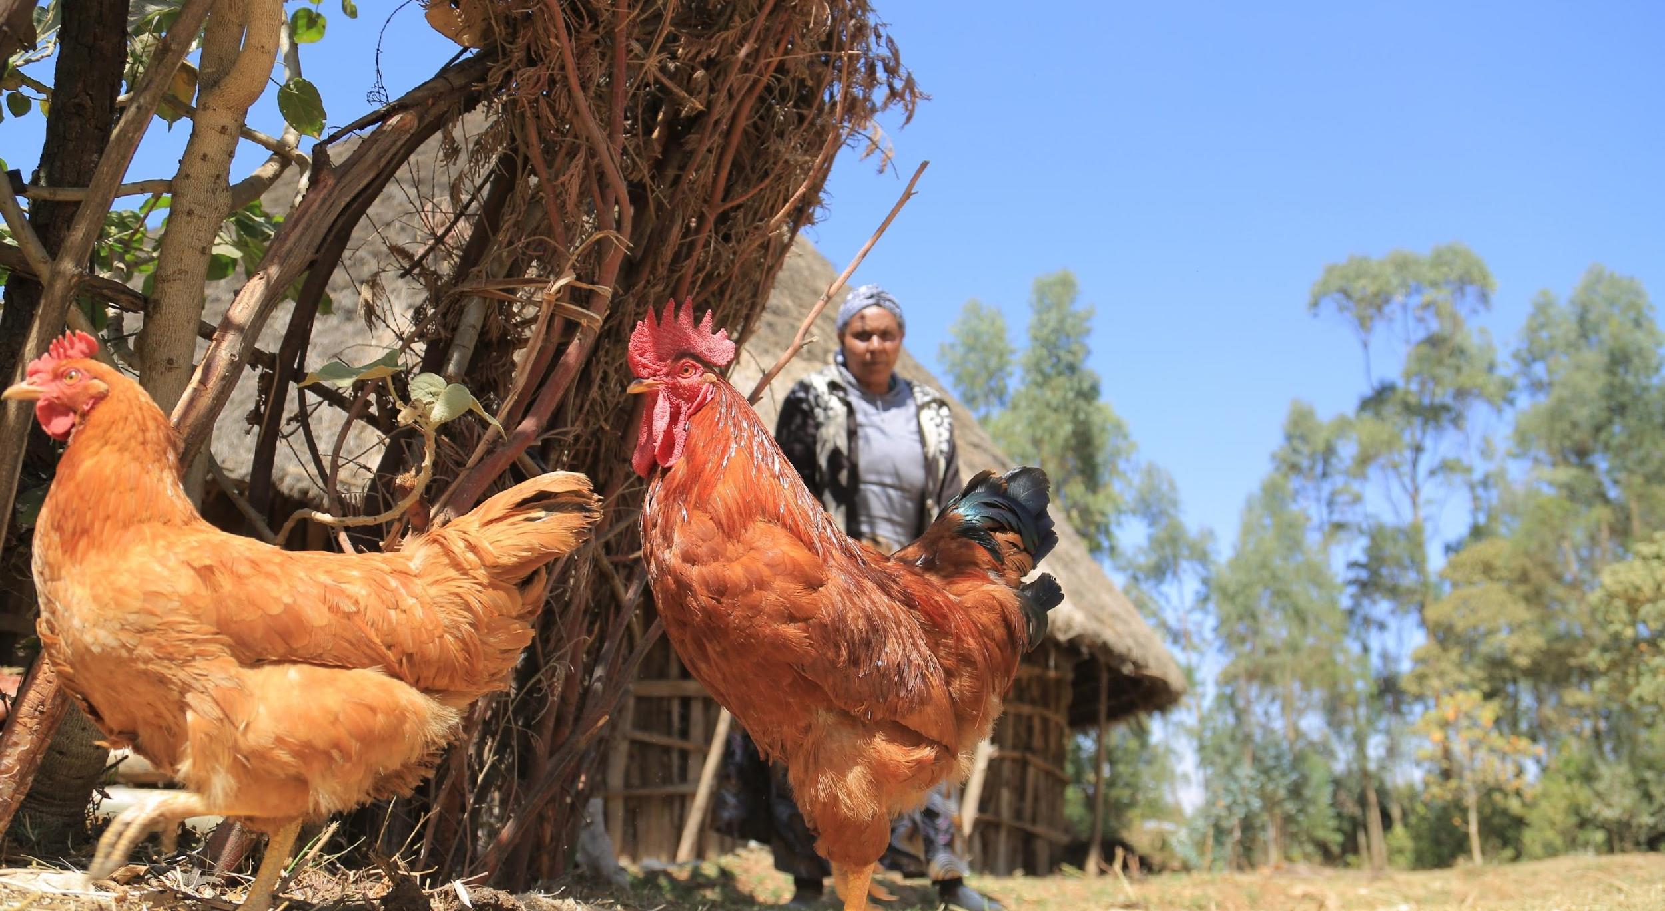
Primer 3
Guiding principles
Private sector actors massively vary in type, context and approach
Early, close and dedicated stakeholder engagement is critical
Engagement and facilitation are needed, even for “warm” investors
Establishing a shared big-picture vision for the partnership at the outset is crucial
Overall partnership success can be enhanced by being purposeful about leveraging each partner's unique contributions and using USAID’s unique ability to broker relationships

