Slide 1

World Council of Credit Unions -WOCCU
Agricultural lending methodology by Financial Cooperatives
Tuesday Feb 27, 2018
Jean Thiboutot
WOCCU CDP Director
WOCCU / Technical Services

Slide 2
Agenda:
1. Brief introduction - WOCCU
2. Evolution of agricultural lending over last 25 years of US government funded projects
3. Guatemala : MICOOPE network
4. The Guatemala agricultural lending methodology
5. Impact and results
6. Kenya KUSCCO and adjustments to the methodology
7. Conclusion & recommendations
- Questions

Slide 3

WOCCU Worldwide…
countries
continents
Improving people’s lives through credit unions

Slide 4
World Council of Credit Unions
Trade Association:
Provides education, global networking and events for the exchange of information and ideas.
Global Women’s Leadership Network
International Credit Union (ICU) Day
World Council Young Credit Union Professionals (WYCUP) Scholarship Program
World Credit Union Conference
Advocacy on behalf of Credit Unions members to
Improve credit unions’ regulatory framework; and Representation before international standard setters:
Bank for International Settlements
European Union
Financial Action Task Force
Financial Stability Board
International Accounting Standards Board
United Nations
World Bank

Slide 5
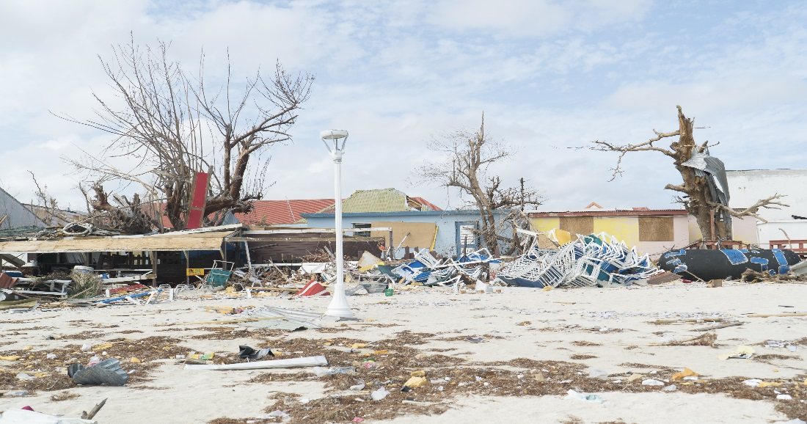
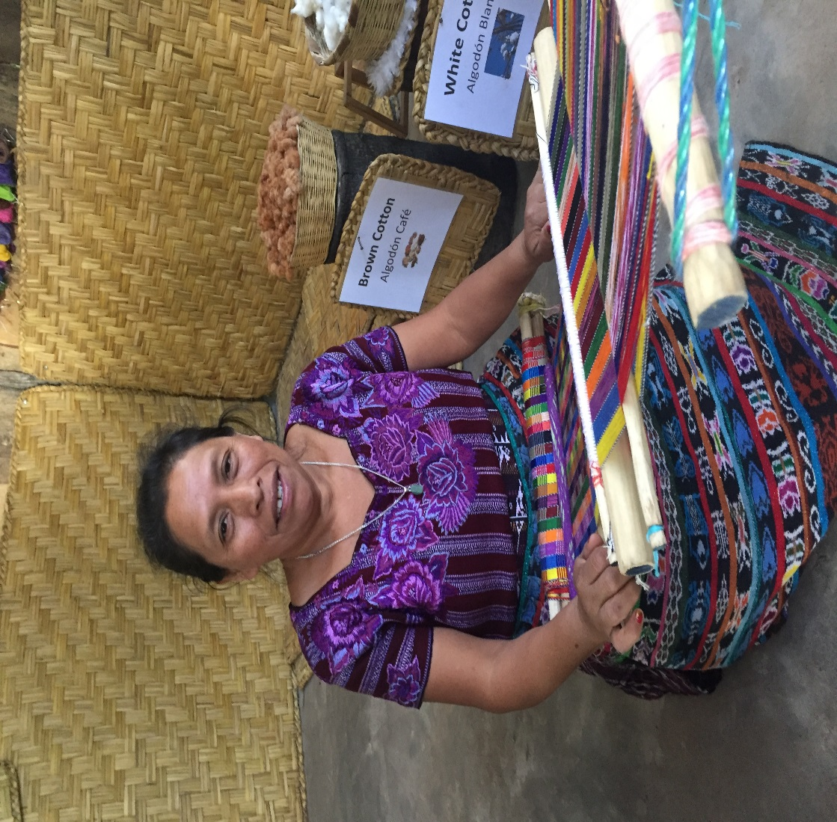
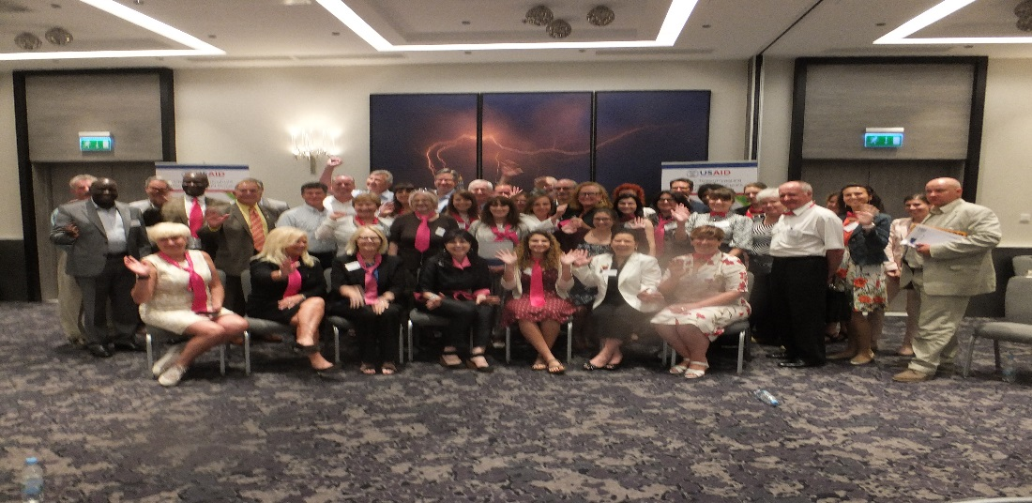
Worldwide Foundation for Credit Unions
Donations support:
Field Engagement Programs | Credit Union Development International Partnerships | Disaster Relief

Slide 6




World Credit Union Conference
www.wcuc.org

Slide 7
WOCCU Development & Technical Assistance
Since 1971, over 300 technical assistance programs in 89 countries, Current programs in 7 countries
Approach :
Strengthen national associations (MCUB)
Expand products and services to meet user demand, including agricultural lending (VC), SMEs, insurance,
Improve network and outreach through digital finance
Encourage legislative reform and regulatory
system development
Promote gender equity
Advance financial inclusion and literacy to the underserved: women, youth, rural poor

Slide 8
2. Evolution of Agricultural lending over last 25 years of US government funded projects
1993: WOCCU- NCBA CLUSA small farmer project in El Salvador. (FGs & CU SG loans)
1999: WOCCU – NCBA-CLUSA, Nicaragua (Improved ag production with CU SG loans)
2002: WOCCU - Nicaragua, CU League - sesame crop (Loans to FGs with ag T.A. & market)
2003: Rwanda - Nicaraguan model implemented for coffee producers and livestock & individual credit to farmers; T.A. replace experience, MT loans for equipment.
2004: WOCCU - Ecuador. Proyecto Crédito Rural con Educación (Small FGs for diversification on and off farm, guarantee fund and insurance)
2008: Kenya (USDA) – (farmers into FG & SG, input vouchers, loan = crop maturity, crop sold to VC actors who signed agreement with CU).
2009: Peru. WOCCU Value Chain Finance. Stronger CUs financing all types of VC (Ag & handicrafts), producers T.A. and CUs hired specialized staff.
2010: Sri Lanka –SG Ag loans to subsistence farmers with Ag T.A. mandatory, loan contract connected to one buyer who repays CU.

Slide 9

3. MICOOPE COOP MODEL in GUATEMALA

Slide 10
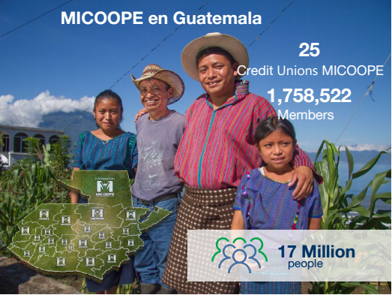
MICOOPE IN GUATEMALA

Slide 11
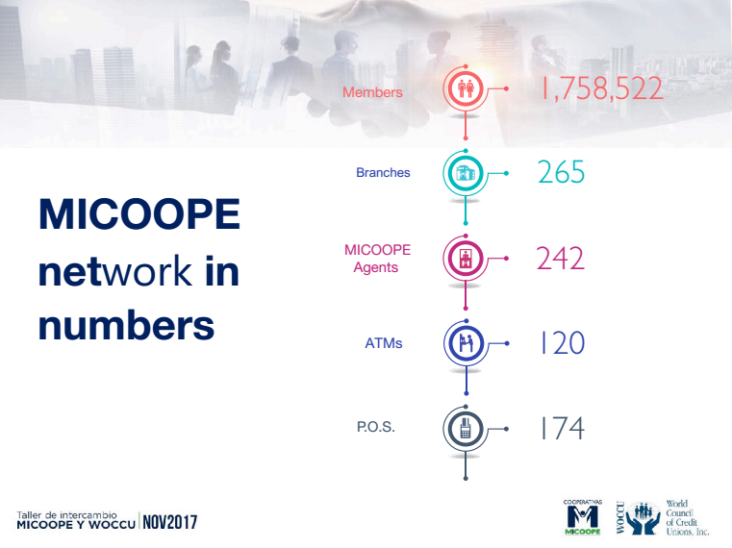
MICOOPE NETWORK

Slide 12
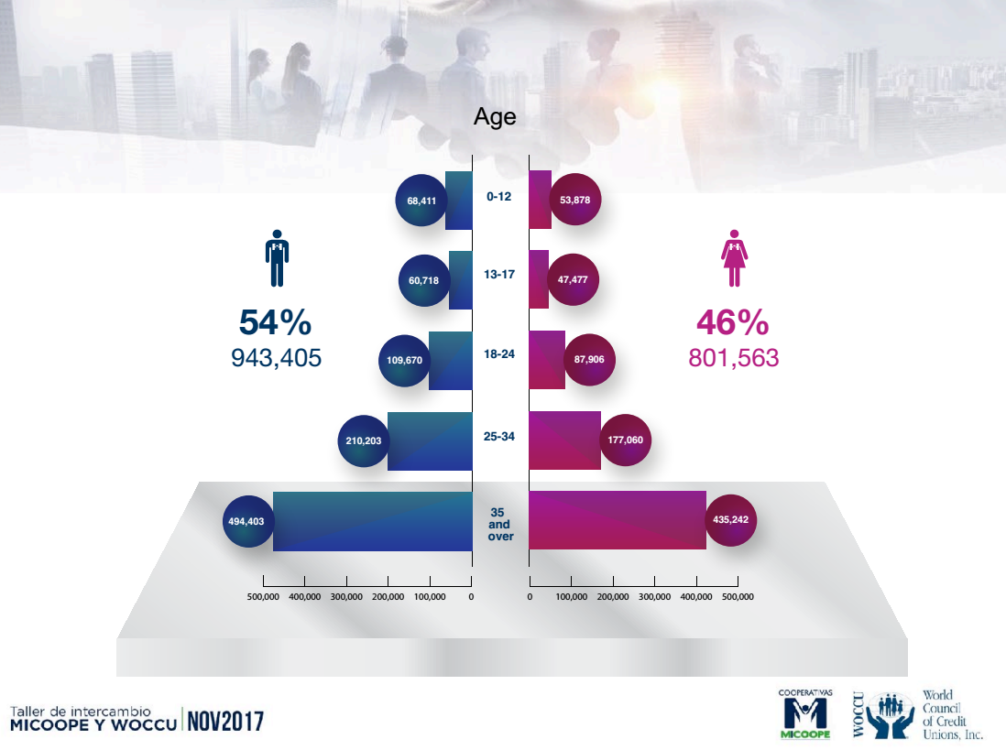
MICOOPE MEMBERSHIP BY AGE & GENDER

Slide 13

MICOOPE INSURANCE PRODUCTS

Slide 14
4. CDP Project and
Guatemala Agricultural
lending methodology

Slide 17
Phase 1 : Organization and Planning
Productive capacity study in the geographical CU area (crops, products, activities, LP, arrears & define what and how).
Definition of business opportunities (field visits, market research, commercial crops).
Identification of agricultural businesses to offer CU services (FG, COOPs, transport, storage, packaging, collect data: volume, cost, price, quality and assess finance needs).
Support to producers organization (skills, yields, market meet and offer services).
Support on market analysis (crops consumer, VCF).

Slide 18
Phase 2: Loan application process
6. Loan application analysis (meet with producer to collect & assess data, plan ).
Individual farm production plans should be compiled by the CUs to support finance needs, ways it will be used and timing of disbursements and collections, etc.
The length of the loan and the interest rate being sought (or offered)
Risks associated with the business and strategies to mitigate them (i.e., are market prices and inputs fluctuating a lot)

Slide 19
Phase 3: Credit analysis and approval
7. Loan application and agricultural insurance management.
8. Loan disbursement is based on farm plan according to the crop production needs and cash flow.

Slide 20
Phase 4: Loan servicing and follow up
9. Implementation of the financed agricultural project (field visits to monitor loan to production vs plan and cash flow and training).
10. Management of the agricultural insurance in the event of a loss (procedure for insurance claims in case of losses).
11. Commercialization support (increase productivity, market based quality and financial literacy.
12. Management of loan repayment process (loan collection, portfolio monitoring & reporting.

Slide 21
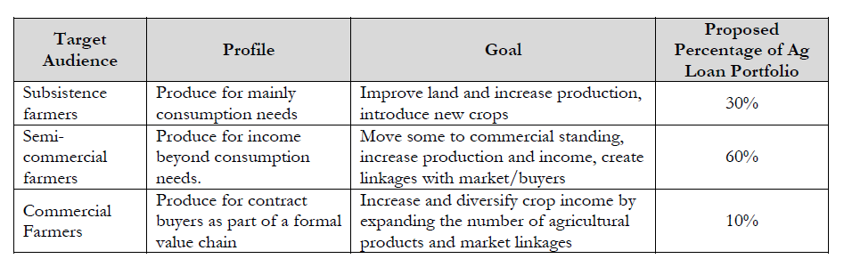
5. Results

Slide 22
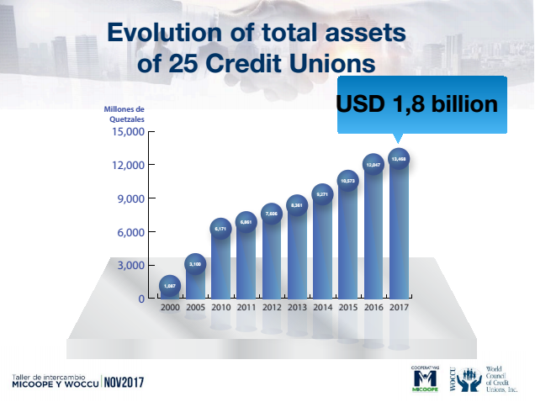

Slide 23
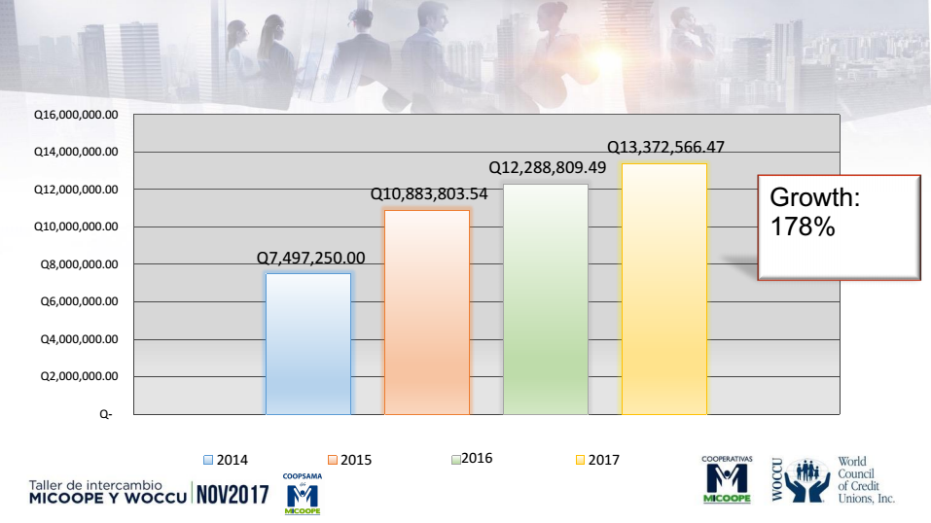
COOPSAMA : Agricultural loan portfolio growth

Slide 24
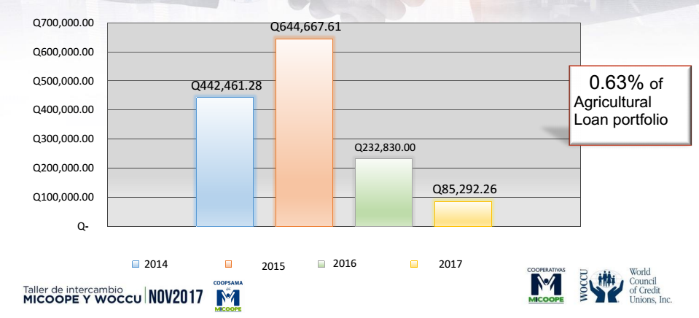
Evolution of Agricultural Loan delinquency

Slide 25
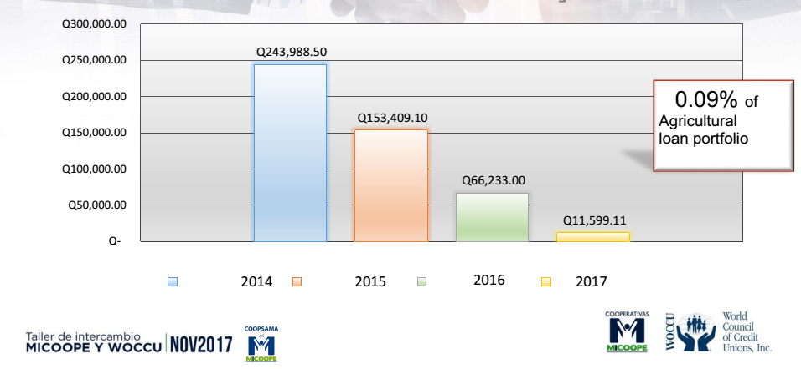
Loans written off

Slide 26
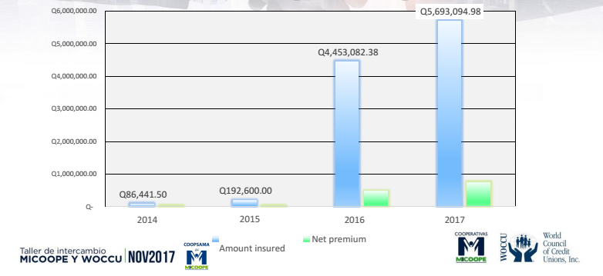
Evolution of the Agricultural insurance

Slide 27
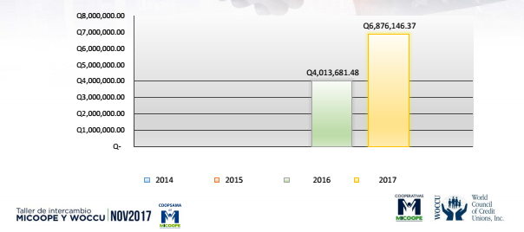
Loan portfolio with Guarantee fund

Slide 28
KUSCCO
6. Kenya Union od Savings and Credit Co-operatives LTD.

Slide 29

Kenya
Mission: Promotion of SACCOs through advocacy and provision of quality innovative and market driven products and services for sustainability
Around 2,000 SACCOs affiliated to KUSCCO and 175 are regulated by SASRA – the SACCO regulating authority in Kenya

Slide 30
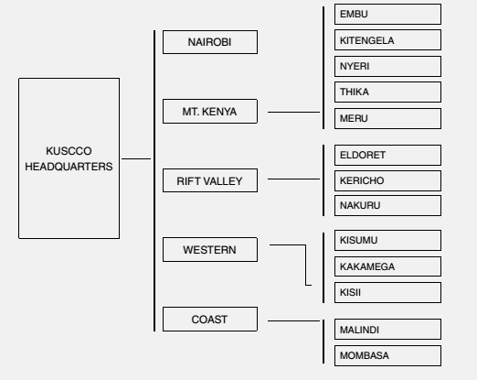
KUSCCO current structure
Ag Unit

Slide 31
Department and services
The Central Finance Fund & Agricultural Unit
Risk management services
Education and training services
Housing fund
Research and Consultancy Services
Corporate affairs (communication and advocacy)
Marketing
ICK – Irnet Coop Kenya Ltd
Business support units (Finance, HR, Audit)

Slide 32
What changed in Kenya?
SACCOs are smaller, closed bond and were financing Ag-lending: shares leverage, monthly payments, real state collateral, without supervision of production unit and with limited savings mobilization capacity.
In Guatemala the initial CDP Agricultural Lending Methodology evolved into an Agribusiness methodology.
In Kenya, from 2013 to 2016, WOCCU tried to do a mix between of two different methodologies: the Value Chain Finance methodology (Peru) and some tools from Guatemala methodology.
In Guatemala, the methodology was developed under the direction MICOOPE, in Kenya, at first that role was replaced by the local WOCCU Project but in 2017 fully brought under KUSCCO with creation of an Ag-Unit.

Slide 33
Similarities and differences
Guatemala | Kenya
Follows WOCCU’s principles on agricultural lending. | It follows WOCCU’s principles on agricultural lending.
Developed a methodology for an Agricultural Loan with technical support from MICOOPE | Develops a methodology for Credit Union level and a source of funding from the second level organization (KUSCCO Central Financial Facility).
Introduce the Agricultural Loan Officer as key personnel in the process. | Option of having or not an Agronomist at the Credit Union level.
Methodology is organized in 12 phases including 17 manuals and tools. | Methodology is organized in 5 modules including one manual and 22 tools. Also, it includes training materials.
It introduces loan insurance and technical support from MICOOPE. | It introduces loan insurance and technical consultancy services from KUSCCO.
 | It introduces the usage of solar energy for powering agriculture and water pumping for irrigation.

Slide 34


Slide 35
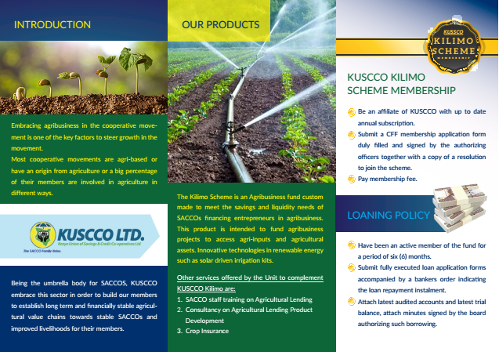

Slide 36
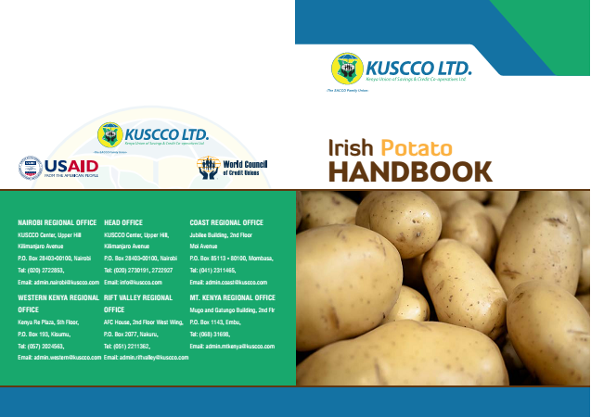

Slide 37
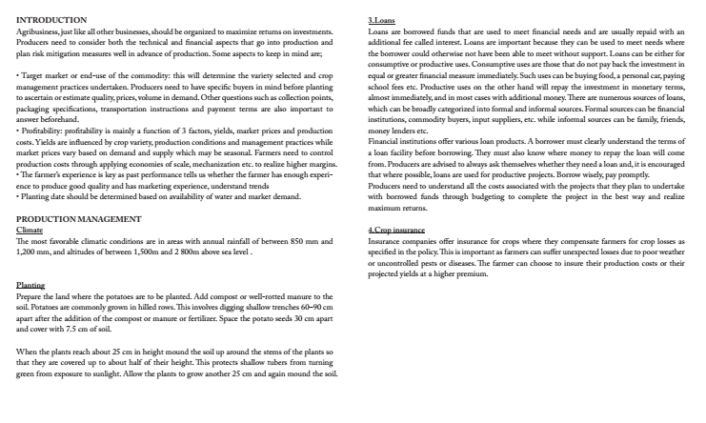

Slide 38
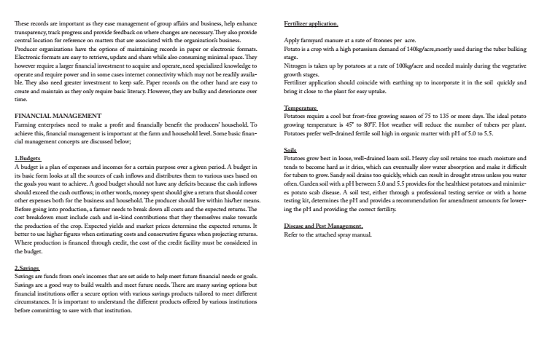

Slide 39
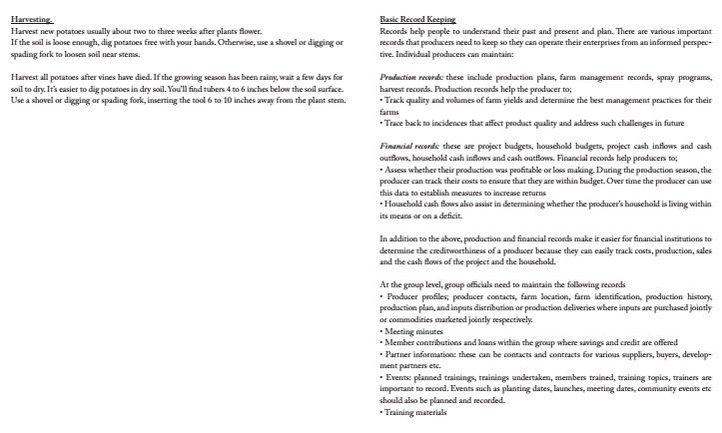

Slide 40
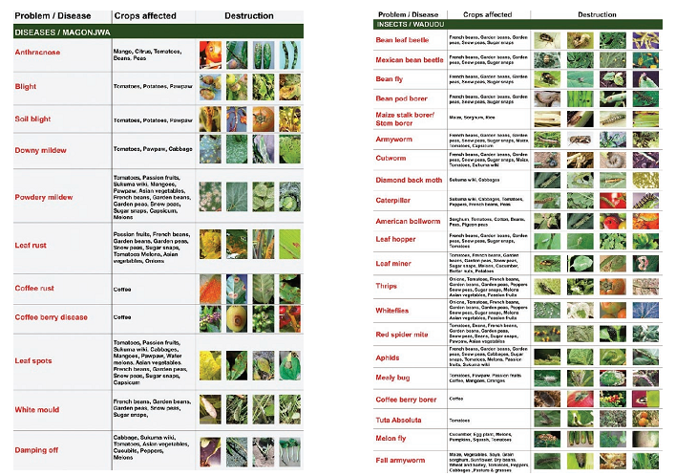

Slide 41
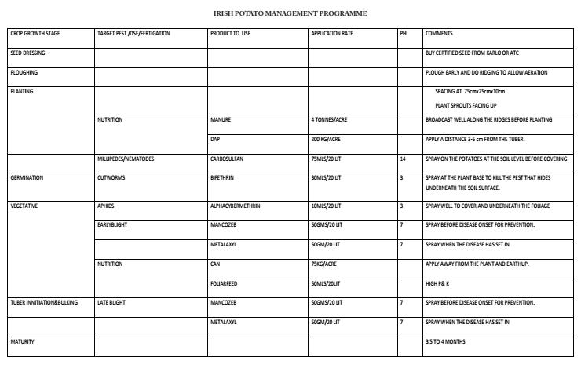

Slide 42
7. Some principles and recommendations on agricultural lending based on CDP program

Slide 43
Ag lending principles
A poorly designed agricultural lending program will:
Make poor farmers poorer & make credit unions poorer
Damage the credit worthiness of small producers and possibly create a poor credit culture where farmers think they don’t have to repay the money they have borrowed, and
Damage the reputation of WOCCU as an effective practitioner of rural and agricultural finance.

Slide 44
New emerging model for agricultural microfinance
1. Treat borrowing households as a repayment unit instead of linking repayment to only loan use.
2. Character-based lending technology combined with technical criteria to select borrowers, set loan terms, and enforce repayment.
3. Savings mechanisms are provided to help borrowers manage resources.
4. Loan Portfolio Risk is highly diversified.
5. Loan terms and conditions are adjusted to accommodate cyclical household cash flows and investments.
6. Contractual arrangements reduce price risks and help guarantee payment.

Slide 45
New emerging model for agricultural microfinance
7. Financial services are delivered on existing institutional infrastructure or using improved technology (mobile banking, smart cards, ATMs, cell phones).
8. Member-based organizations may be viable in remote areas (volunteers, farmer associations).
9. Insurance do protect against some production risks
10. Agricultural microfinance must be insulated from political interference (debt pardoning, interest rate subsidies, poor repayment).

Slide 46
Questions:

